Slide 1


Project Luther: Understanding impact of weather on bike commuter traffic across Fremont bridge
Natalia Lichagina
Jan 25th, 2019

Slide 2
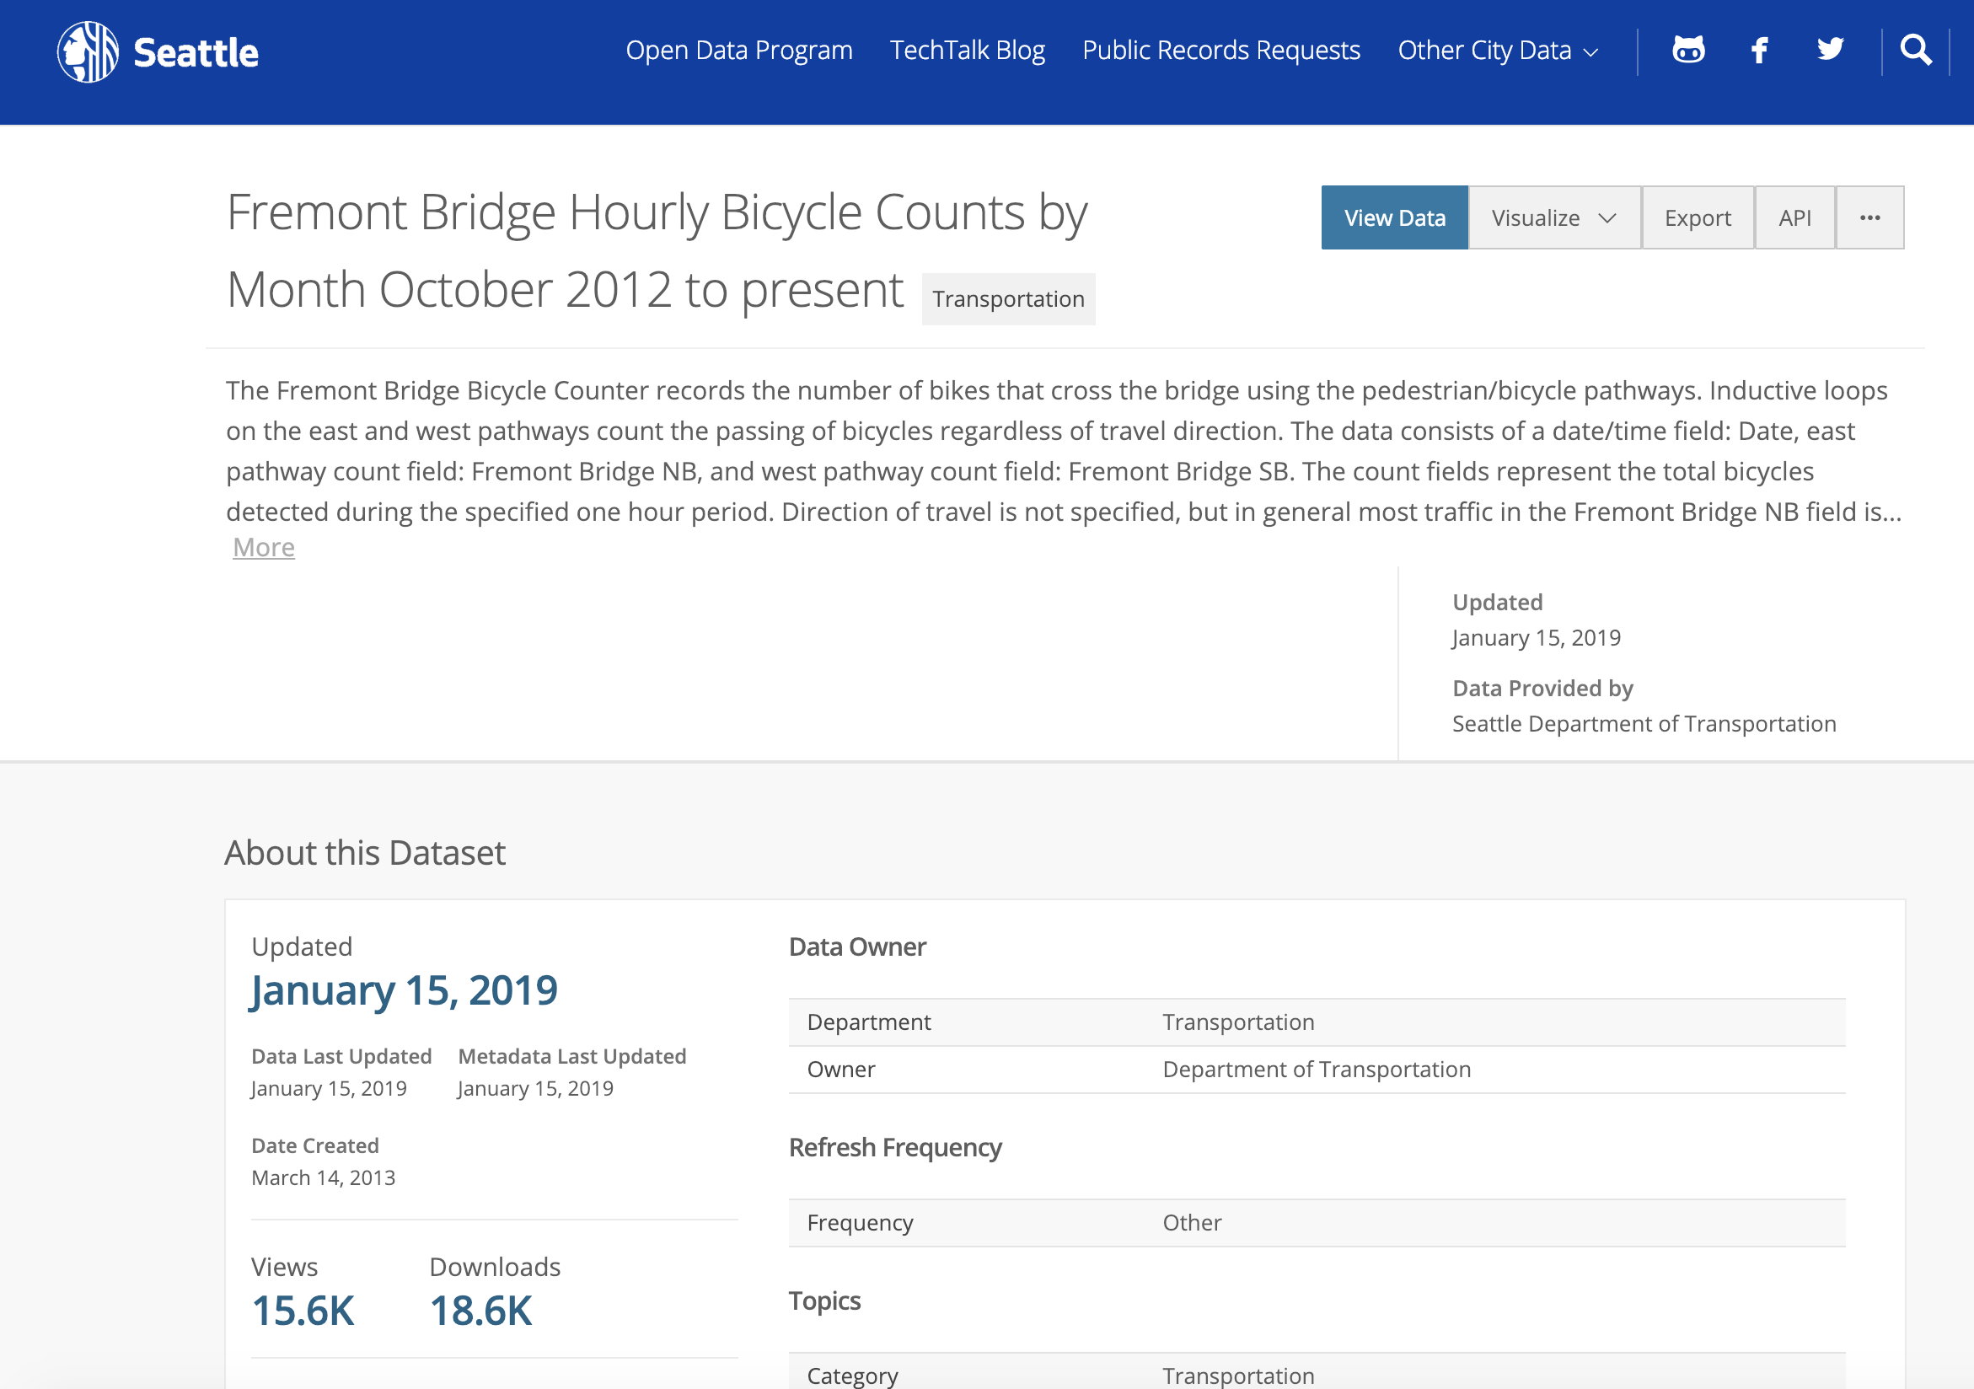
SDOT makes excellent traffic data available for easy download

Slide 3
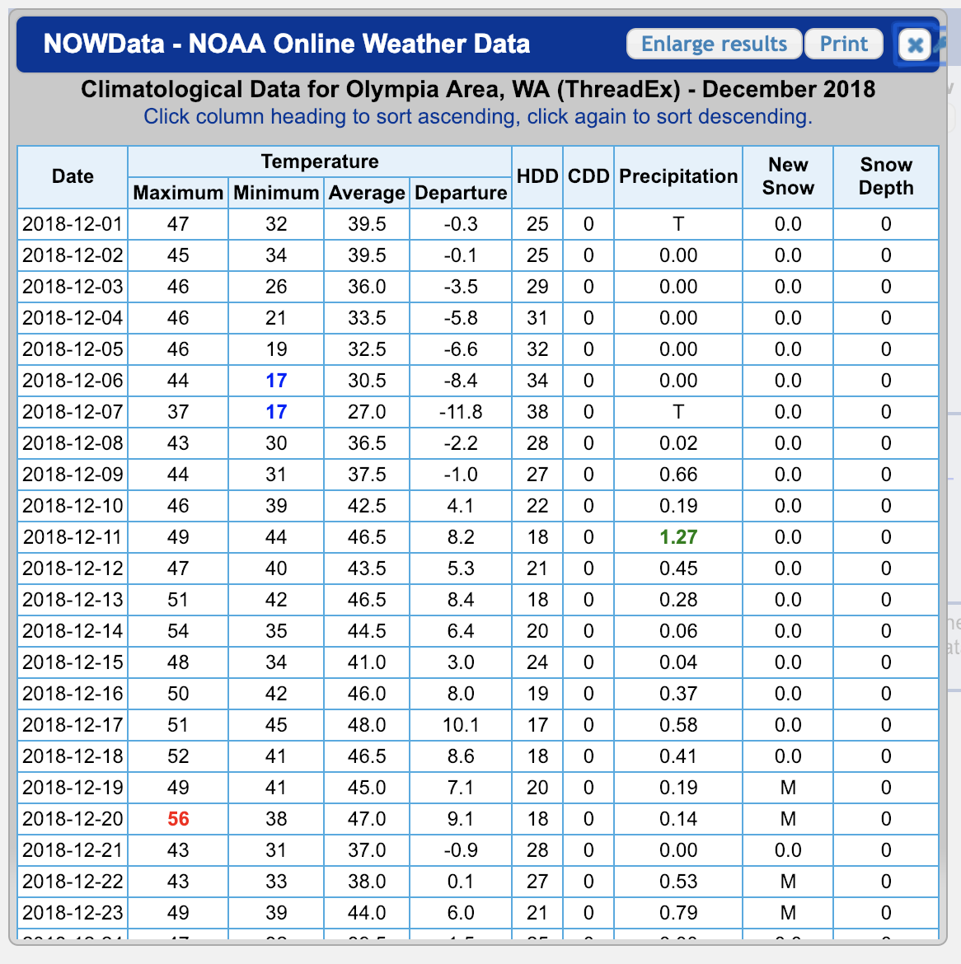
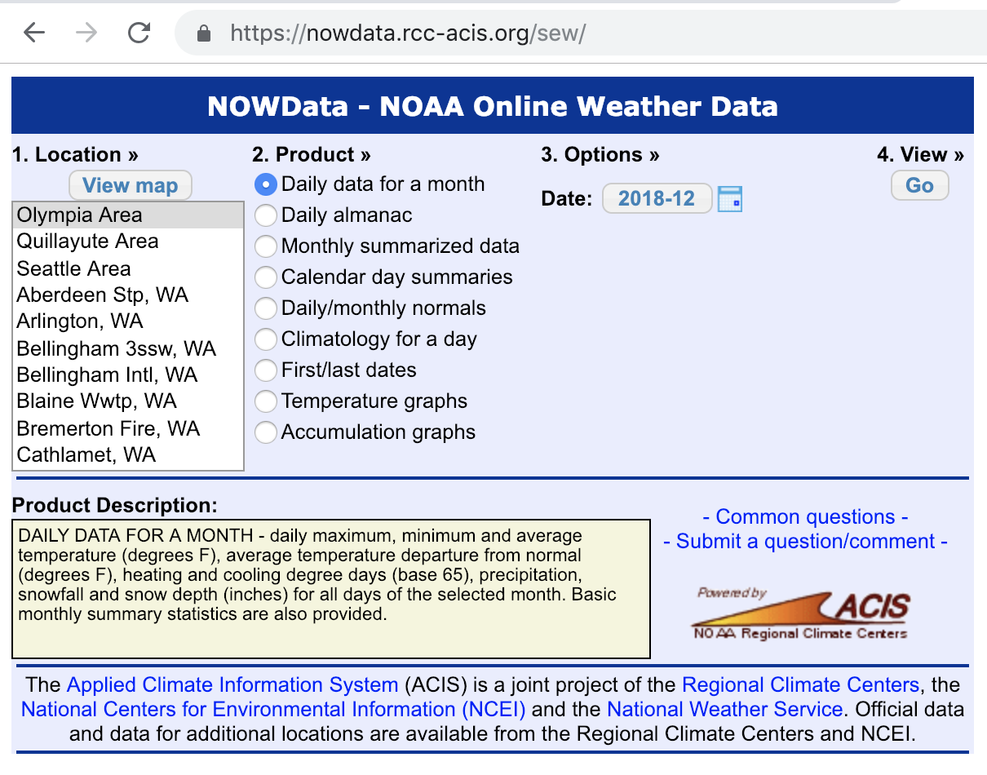
Weather data had to be scraped

Slide 4
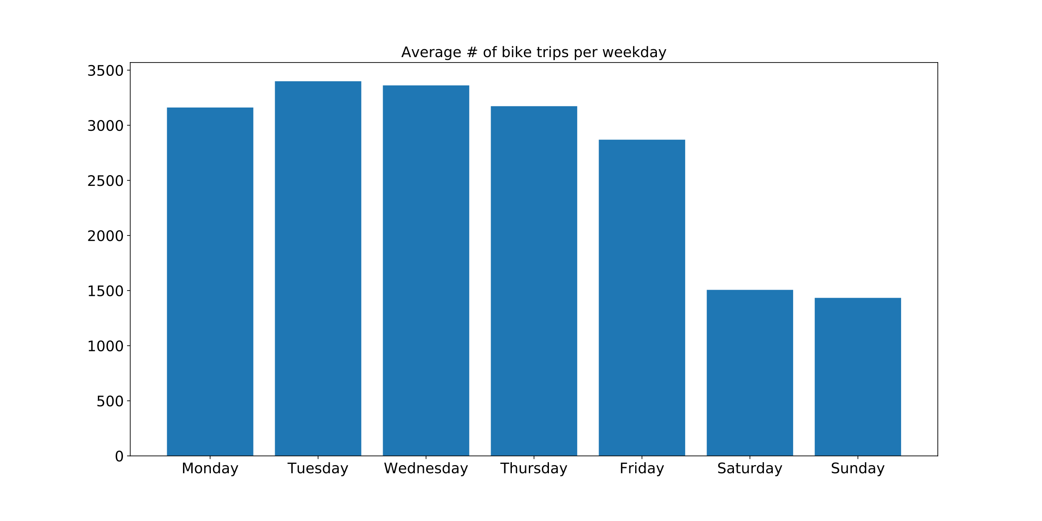
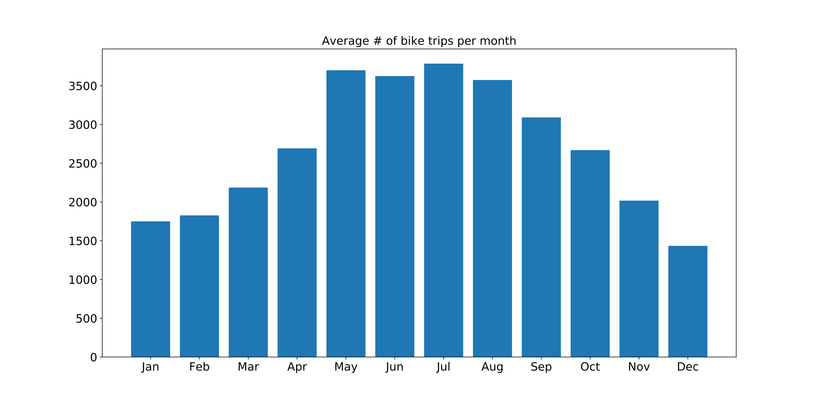
The overall traffic flow was predictable and steady

Slide 5
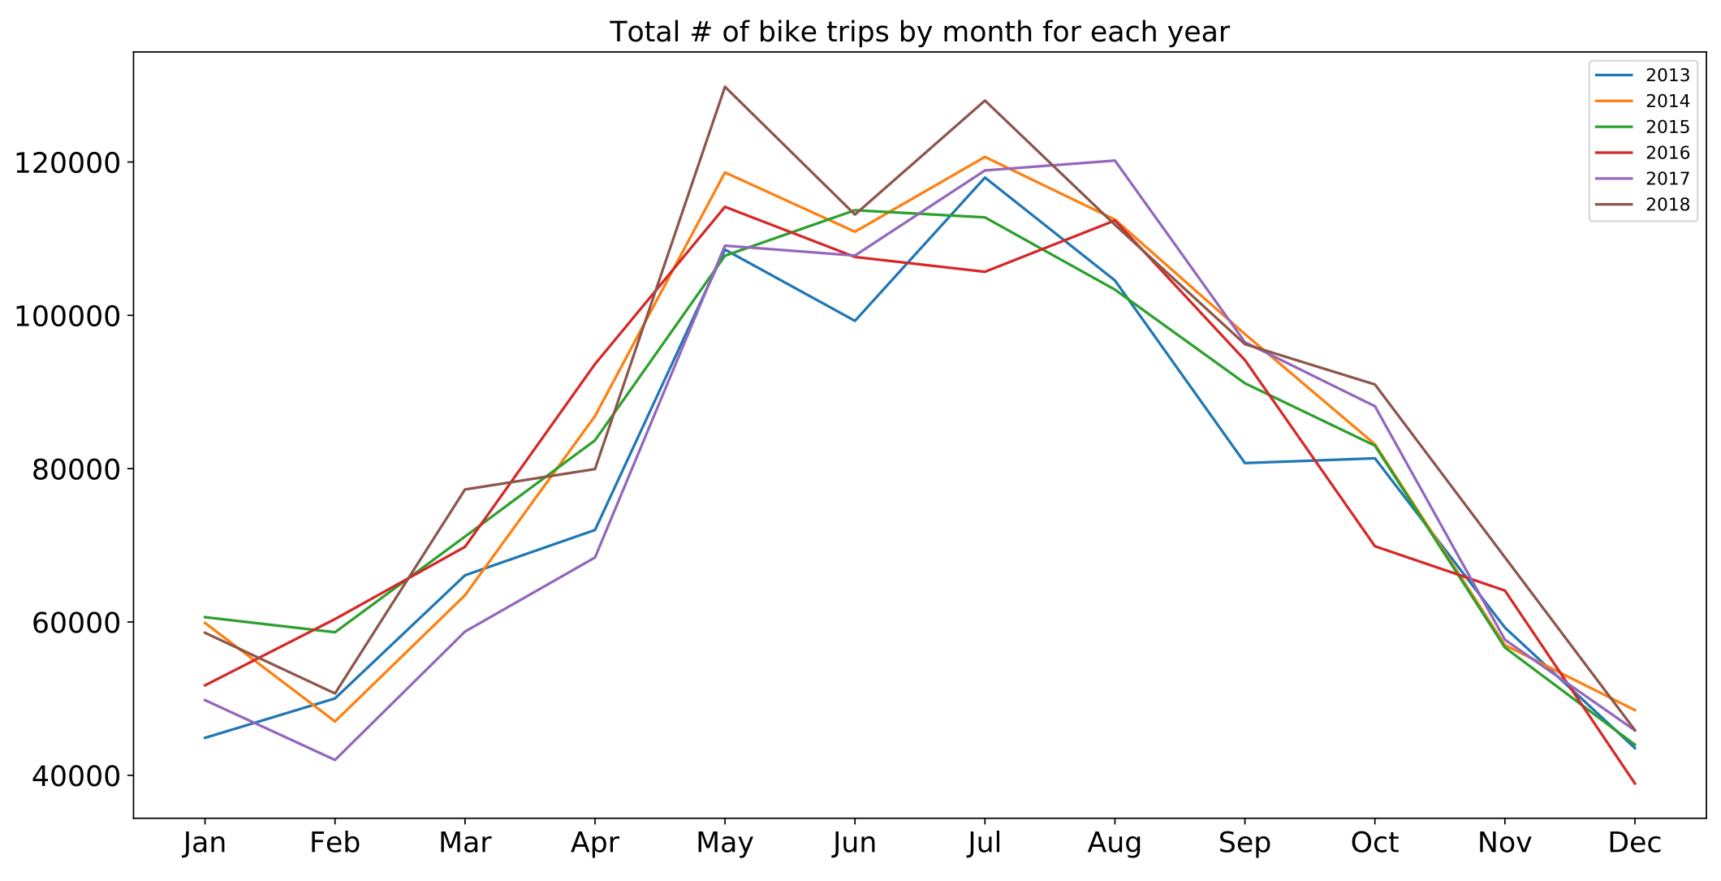
The model was built on 2013-2017 data, with 2018 reserved for testing

Slide 6
The dataset changed a lot from start to finish
Initial
Added
Transformed
Added
Date
East
West
Temp-Max
Temp-Min
Temp-Avg
Precipitation
Legend:
New Snow
Datetime
Float/integer
Snow Depth
Categorical
Boolean

Slide 7
The dataset changed a lot from start to finish
Initial
Added
Transformed
Added
Date
Weekday
East
Year
West
Month
Temp-Max
Is holiday
Temp-Min
EW
Temp-Avg
Temp HiLo delta
Precipitation
Legend:
New Snow
Datetime
Float/integer
Snow Depth
Categorical
Boolean

Slide 8
The dataset changed a lot from start to finish
Initial
Added
Transformed
Added
Date
Weekday
Sin_month
East
Year
Cos_month
West
Month
Monday
Temp-Max
Is holiday
Tuesday
Temp-Min
EW
Wednesday
Temp-Avg
Temp HiLo delta
Thursday
Precipitation
Friday
Legend:
New Snow
Saturday
Datetime
Float/integer
Snow Depth
Categorical
Boolean

Slide 9
The dataset changed a lot from start to finish
Initial
Added
Transformed
Added
Date
Weekday
Sin_month
East
Year
Cos_month
West
Month
Monday
Temp-Max
Is holiday
Tuesday
Temp-Min
EW
Wednesday
Temp-Avg
Temp HiLo delta
Thursday
Precipitation
Friday
Legend:
New Snow
Saturday
Datetime
Float/integer
Snow Depth
Categorical
Boolean

Slide 10
The dataset changed a lot from start to finish
Initial
Added
Transformed
Added
Date
Weekday
Sin_month
Weekend rain
East
Year
Cos_month
Precip^2
West
Month
Monday
Temp-Max
Is holiday
Tuesday
Temp-Min
EW
Wednesday
Temp-Avg
Temp HiLo delta
Thursday
Precipitation
Friday
Legend:
New Snow
Saturday
Datetime
Float/integer
Snow Depth
Categorical
Boolean

Slide 11
Lasso and OLS performed similarly in 5-fold cross-validation
OLS
Lasso
lambda = 0.74
R^2 = 0.884
R^2 = 0.883

Slide 12
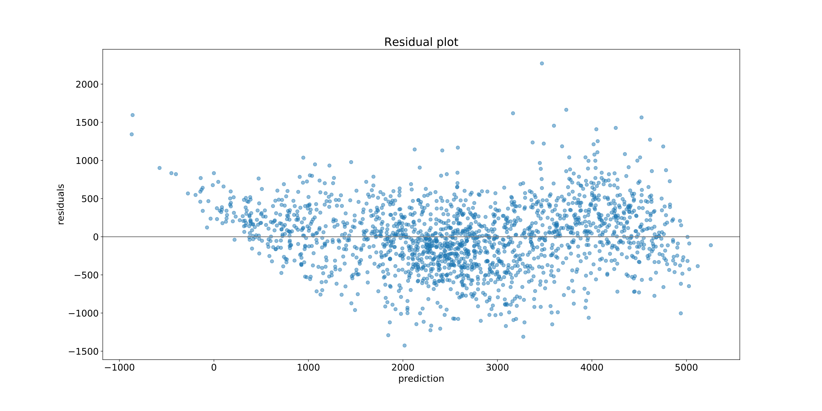
Overall residuals looked (mostly) good

Slide 13
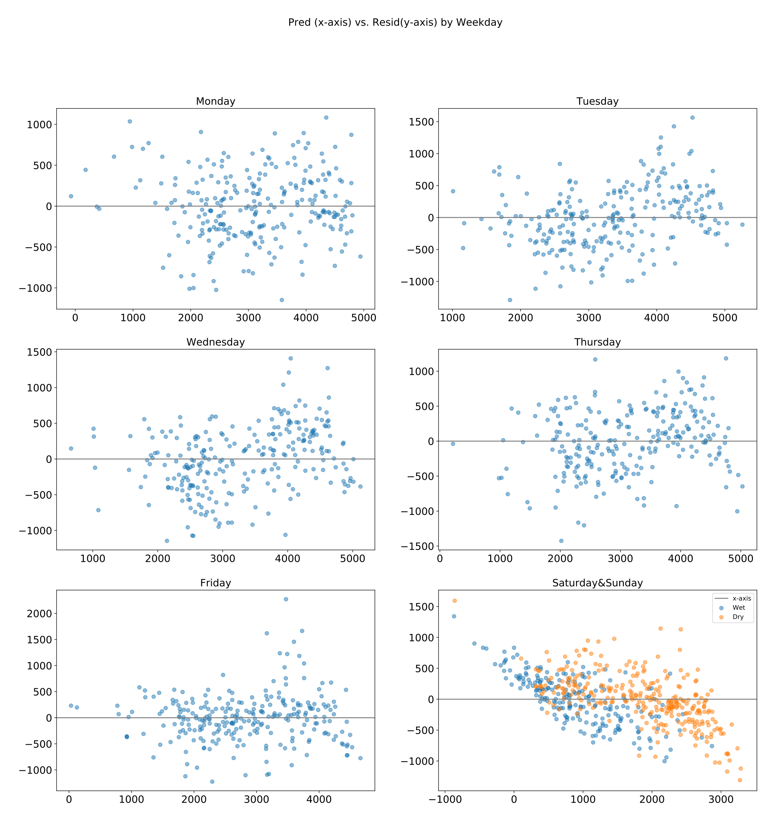
However, further investigation is needed to fix the pattern in weekend residuals

Slide 14
Weather data bumps up R^2 by 12 points
With weather
Without weather
R^2 = 0.886
Adj R^2 = 0.885
R^2 = 0.769
Adj R^2 = 0.768

Slide 15
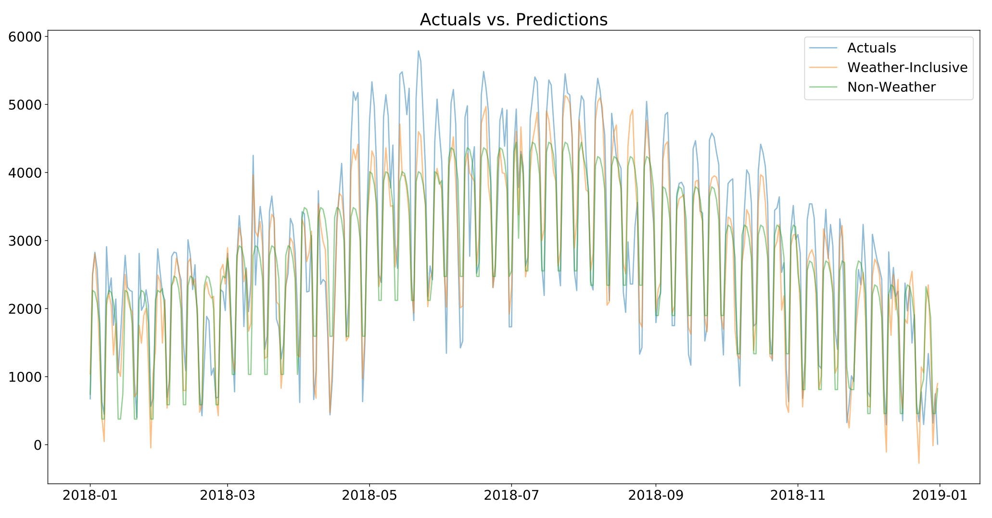
Predictions vs. actuals

Slide 16
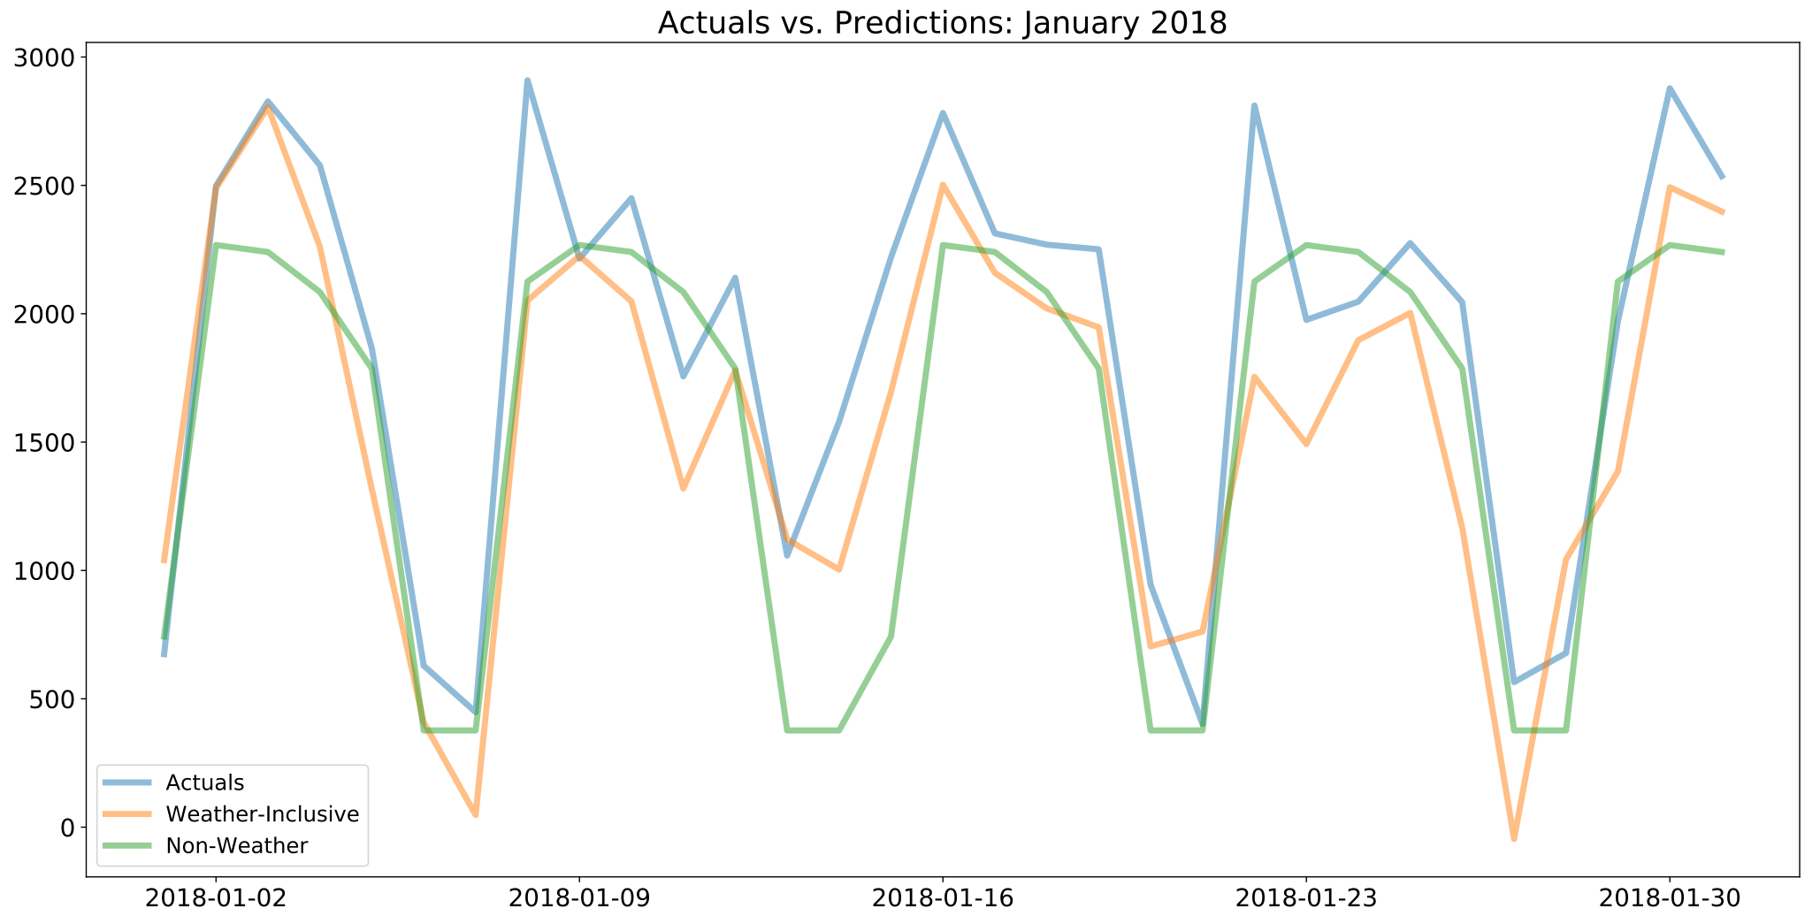
Predictions vs. actuals

Slide 17
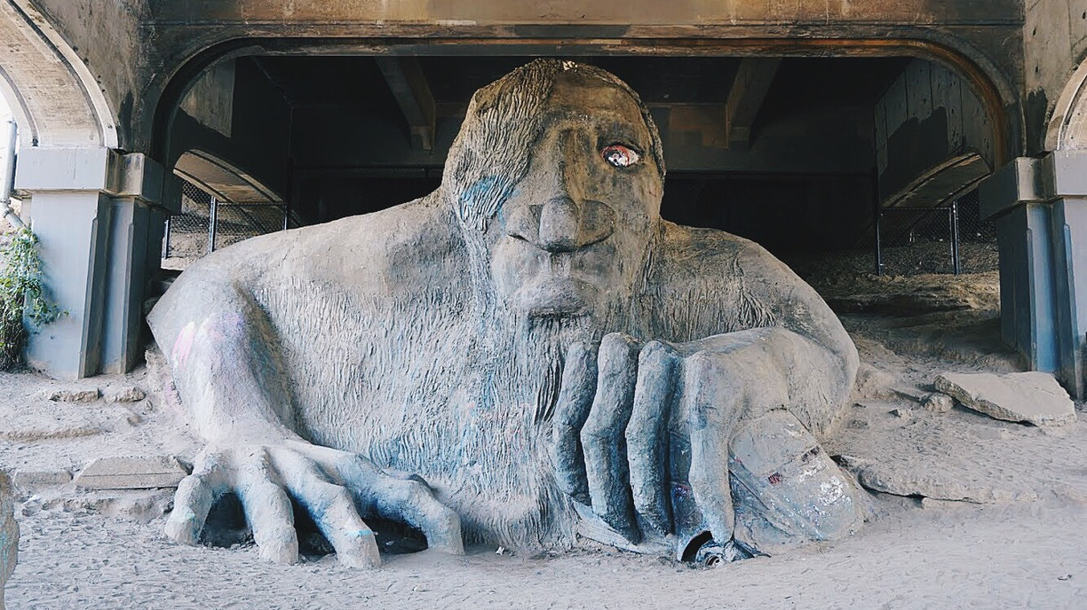
On average, the weather influences the number of bike commuters through Fremont bridge by 10%

Slide 18
APPENDIX

Slide 19
Data sources & tools
Hourly bike counts across Fremont bridge, 2012 to present: https://data.seattle.gov/Transportation/Fremont-Bridge-Hourly-Bicycle-Counts-by-Month-Octo/65db-xm6k
Daily weather data for Washington state stations:
https://nowdata.rcc-acis.org/sew/
Tools:

Slide 20
Full list of columns in the final dataset
Initial
Added
Transformed
Added
Date
Weekday
Sin_month
Weekend rain
East
Year
Cos_month
Precip^2
West
Month
Monday
Pred
Temp-Max
Is holiday
Tuesday
Resid
Temp-Min
EW
Wednesday
Pred_nW
Temp-Avg
Temp HiLo delta
Thursday
Resid_nW
Precipitation
Friday
Legend:
New Snow
Saturday
Datetime
Float/integer
Snow Depth
Sunday
Categorical
Boolean

Slide 21
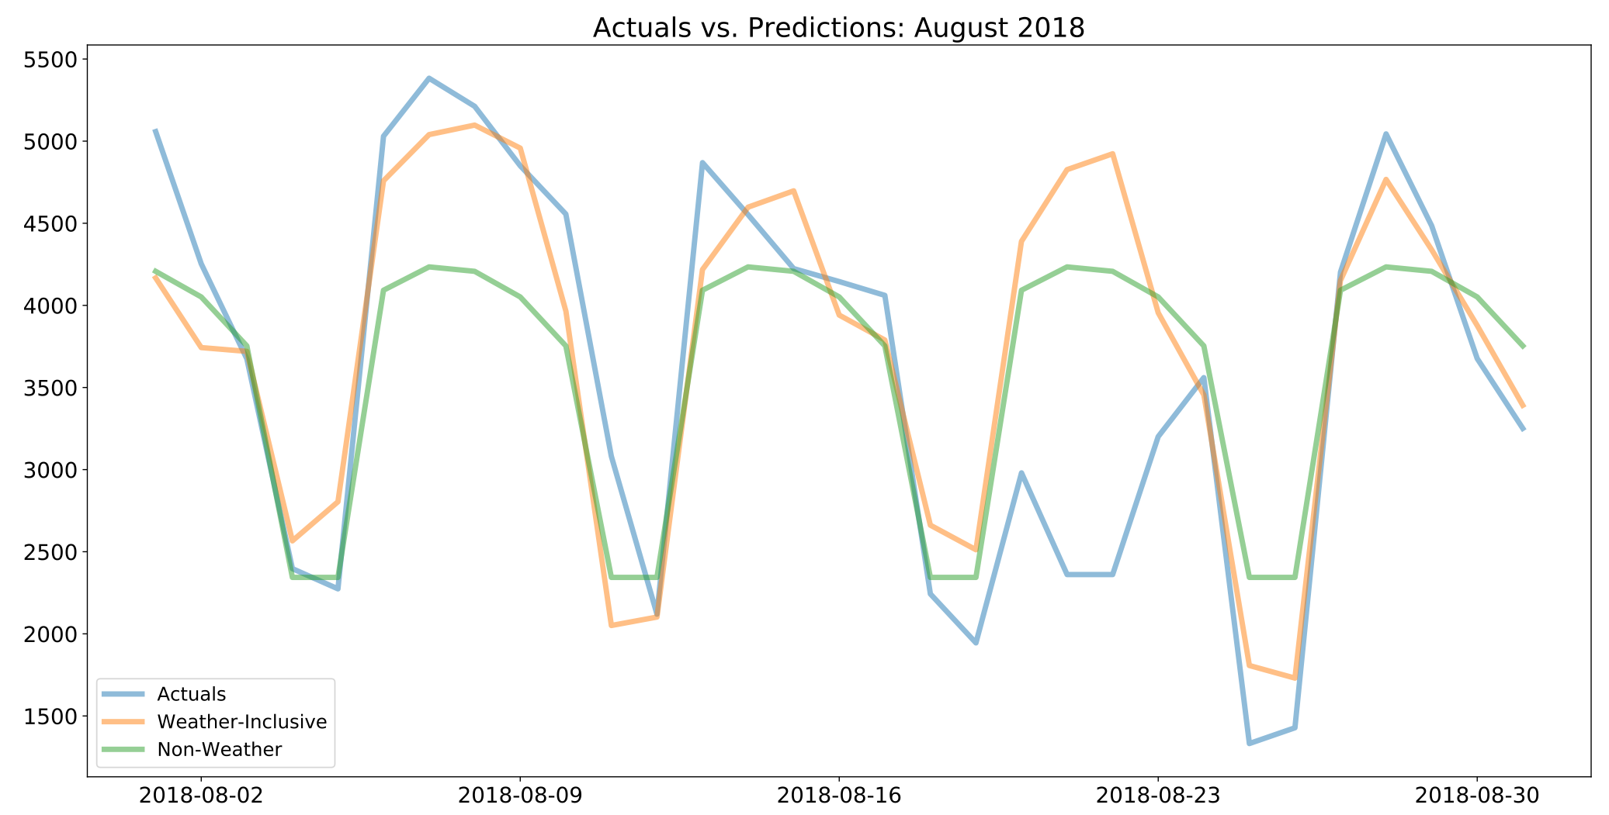
Predictions vs. actuals

